Slide 1
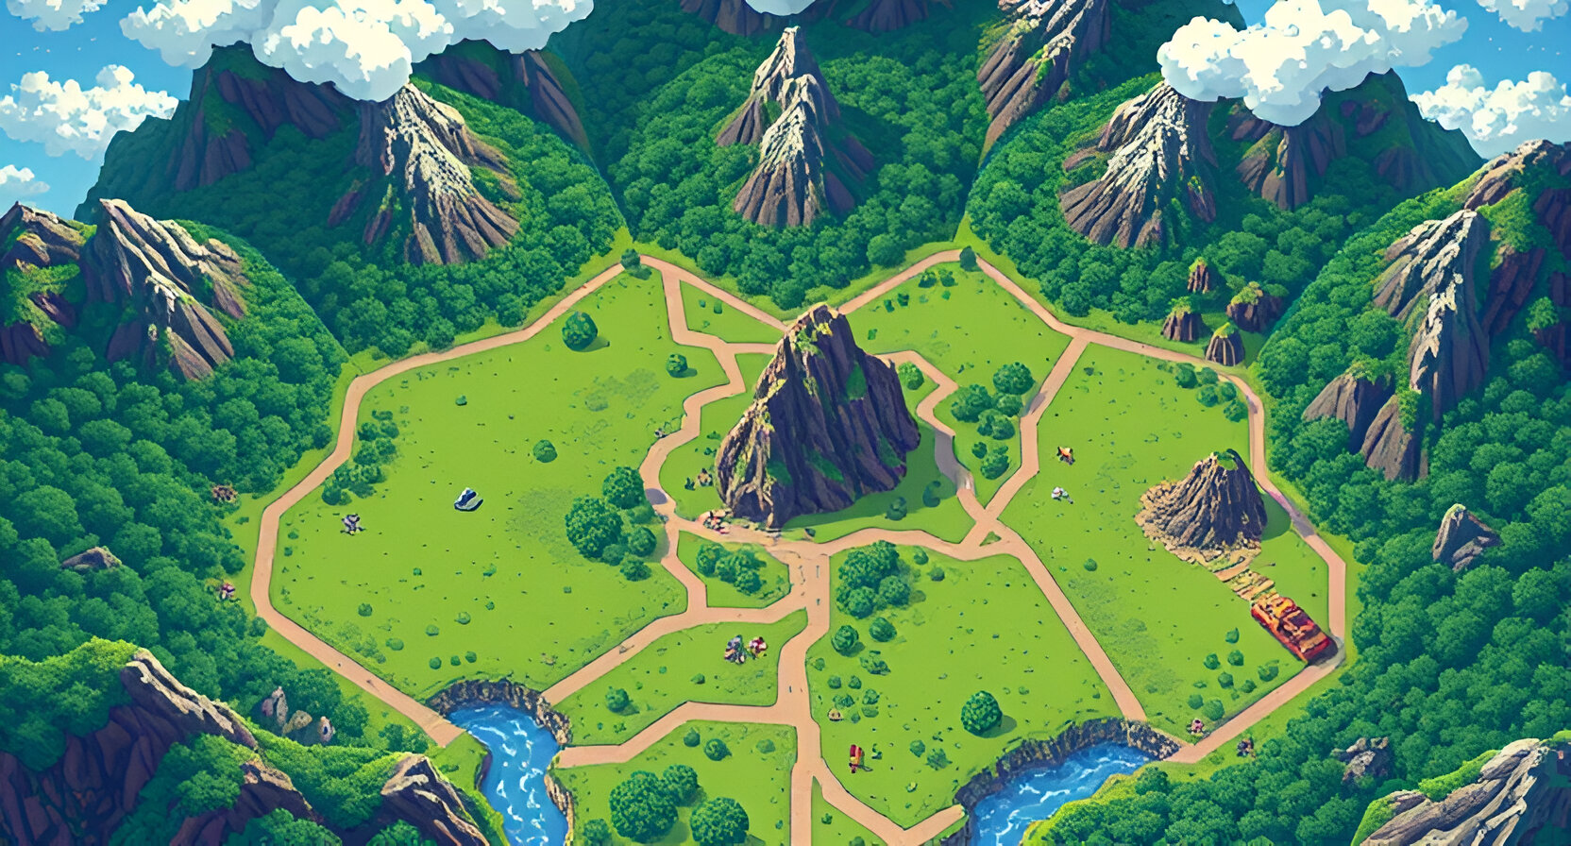

Core Battle Arena
A Two-Player Strategy Board Game
By Team: Core Strikers
Members:
Rahul Singh Rawat Harsh Shukla

Slide 2

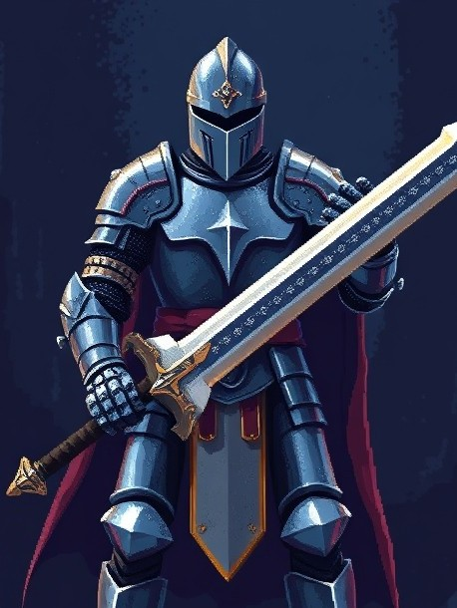
What is Core Battle Arena?
Core Battle Arena is a strategic two-player, turn-based board game that emphasizes skillful planning, piece management, and tactical combat.
Turn-Based Strategy: Each player takes turns deploying, moving, or attacking with their pieces on the battlefield.
Board of Battlefield: The board’s layout encourages players to think strategically about positioning, as adjacency, unoccupied nodes, and movement range dictate possible actions.

Slide 3
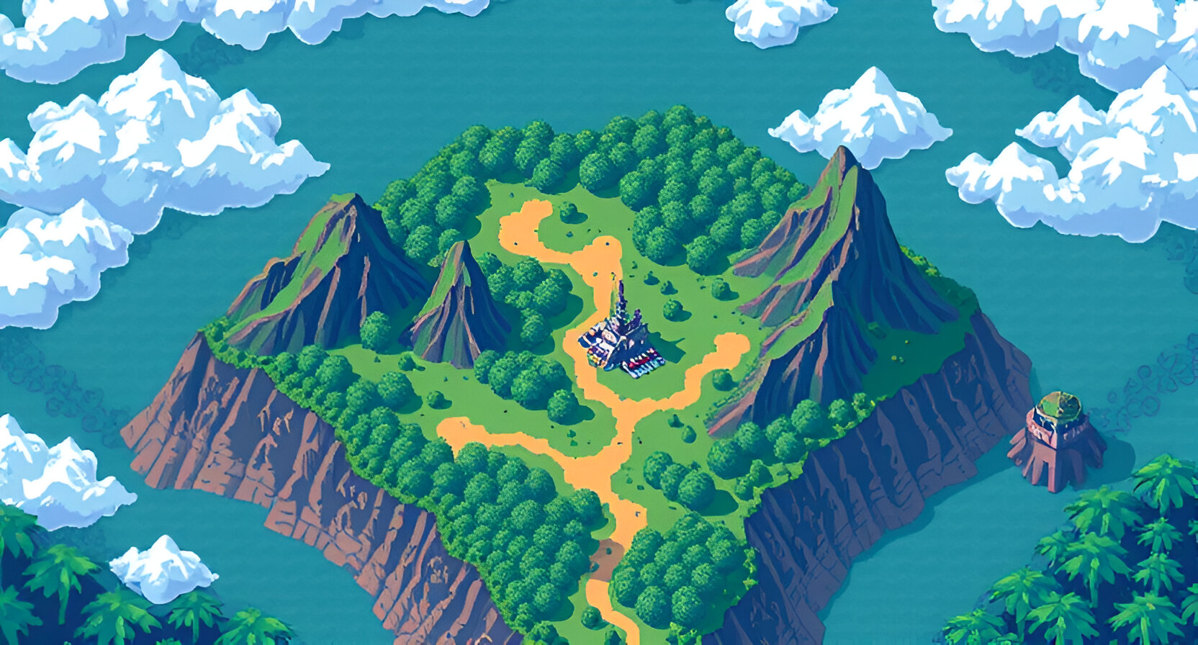

Why Create Core Battle Arena?
Modernizing Classics: Combines the nostalgia of classic board games with unique pieces.
Accessibility: Can be played anywhere with anyone
Skill Development: Enhances critical thinking, strategy, and creativity.
Rising Demand: Aligns with the growing trend of web3-based gaming

Slide 4
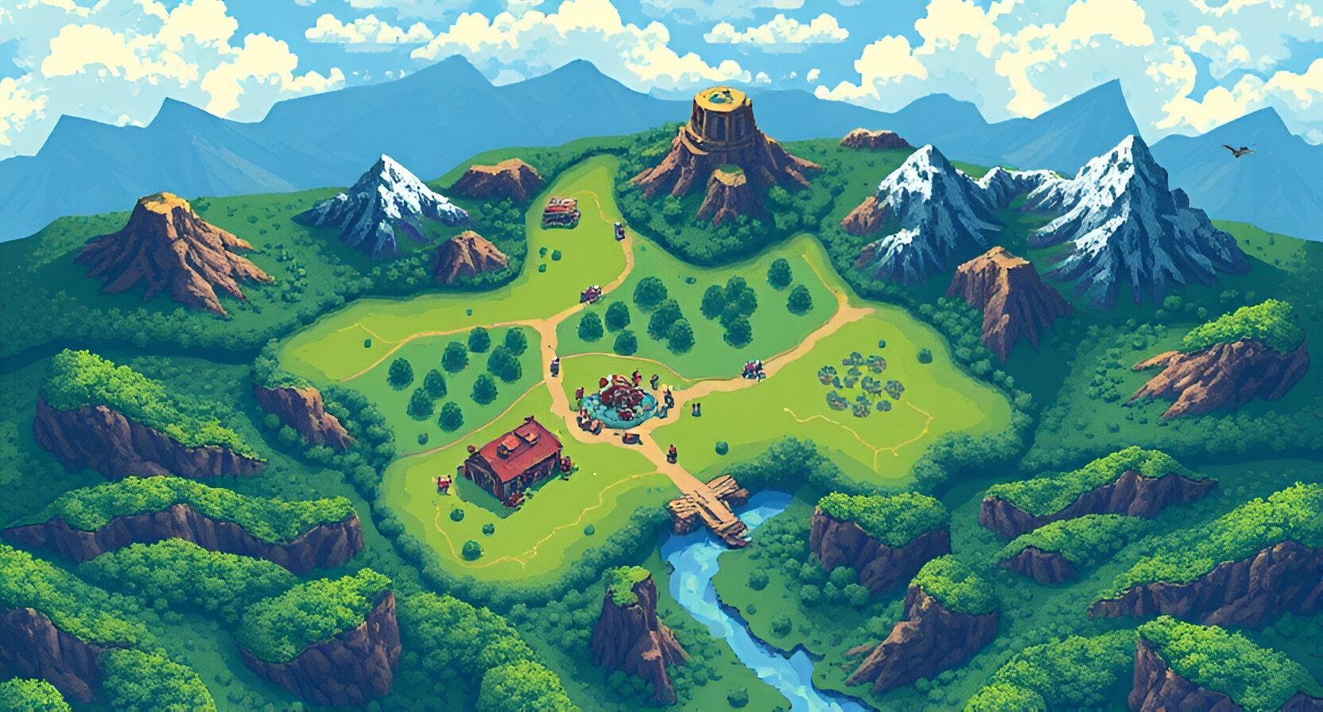
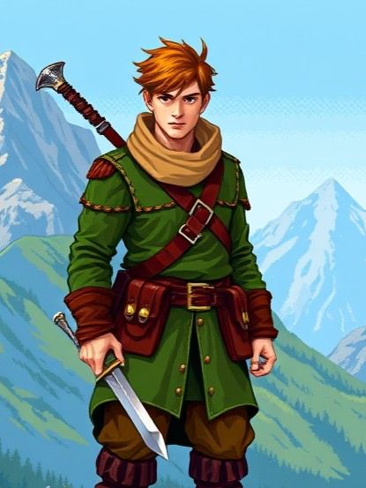
Tech Stack
Frontend:
Vite( React ): For creating an engaging and interactive user interface.
React Router: Enables smooth navigation across game features.
Backend:
Node.js: Handles real-time gameplay mechanics, room creation, and endpoints.
Express: Manages HTTP server functionality
Socket.io: Facilitates real-time communication for multiplayer gameplay.

Slide 5
Tech Stack
Smart Contracts and blockchain:
Foundry: Creation, testing and deployment of smart contracts
CORE: The contract is deployed on Core Blockchain Testnet.
Blockchain Connection:
Ethers: Setting up connection to contracts.

Slide 6
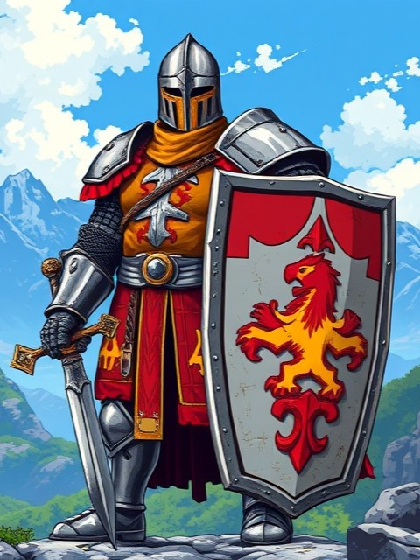
Game Features ( Web2 )
Room-based gameplay: One player creates a room, Other joins using a room code.
Pieces deployment mechanics and battle mechanics.
Unique abilities of each piece and engaging combat system.
Interactive and thematic UI.

Slide 7

Game Features ( Web3 )
Collaboration: High Potential for collaboration with other web3 games.
Buy the skins you like through pure blockchain interaction
Core Collab Skin: Got those Collab skin? There is a unique map waiting for you.
Registering Winner: Both agree on winning of a player? Let the blockchain know!

Slide 8

Playing The Game
Github Repo : https://github.com/Rahulsinghrawat18/Core-s-Battle-Arena
Deployed Site : https://core-battle-arena.vercel.app/
Basic Instructions are present on ‘How to Play’ on Home screen of the app.

Slide 9
Go ahead! Find an opponent!
Let the Arena awaken!

